Slide 1

HumanAI
RenAIssance Hackathon
Historical text printing irregularities
2024/7 Initial training

Slide 2
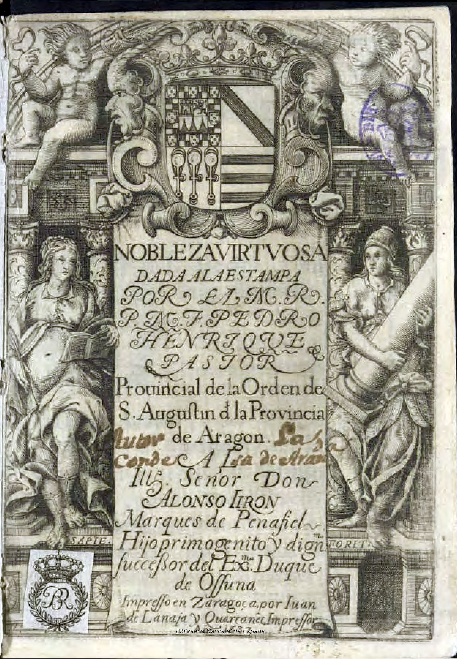
renAIssance Hackathon Test
Transliteration of centuries-old texts represents a research area that is underserved by current tools. RenAIssance encompasses uses of OCR necessary to digitize text sources that have never been processed by machine learning to date. This Hackathon will focus on the application of AI to recognize 17th century Spanish printed sources.
The main dataset consists of 31 scanned pages: 25 have transcriptions available, the last 6 pages of transcriptions have been removed to later evaluate the degree of accuracy and viability of the test method employed.

Slide 3
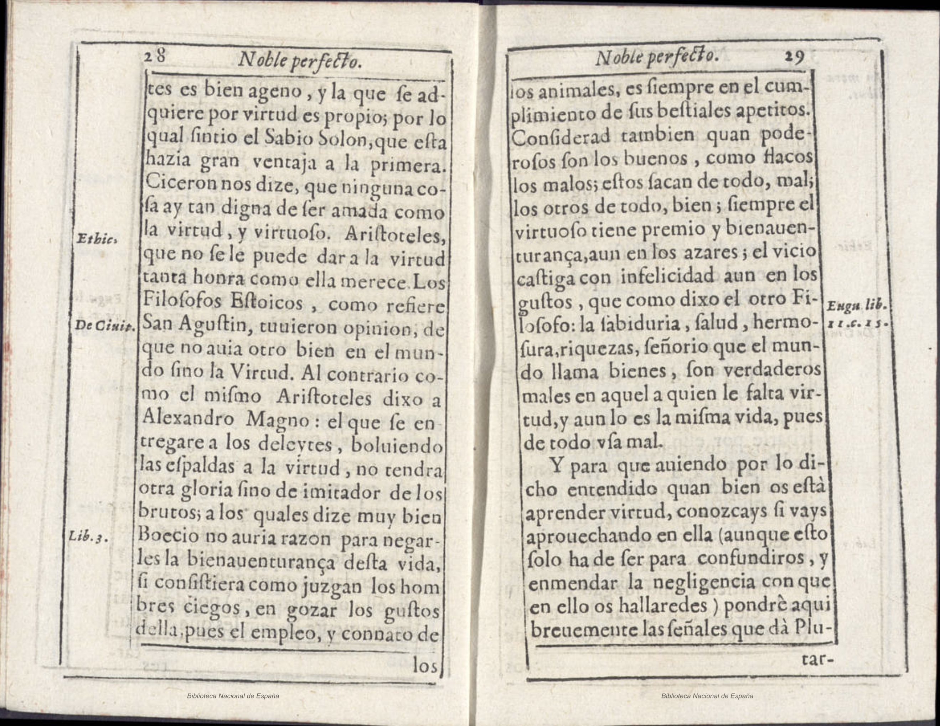

Slide 5
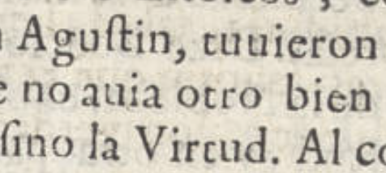
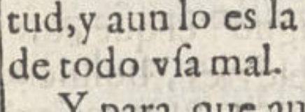
Expected irregularities
u and v are used interchangeably
Assume u at beginning of word
Assume v inside word
Possibility to check against a dictionary?

Slide 6
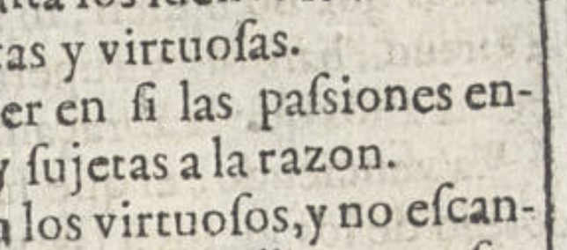
Expected irregularities
f and s are used interchangeably
Could be either f or s at beginning of a word
Could be either f or s inside a word
Sometimes both are present in a word
Assume s at the beginning/end of a word, f within a word
Possibility to check against a dictionary?

Slide 7
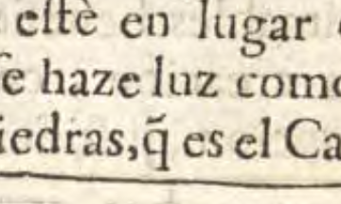
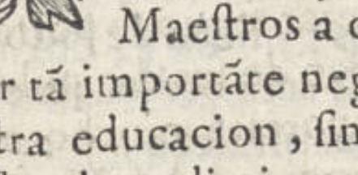
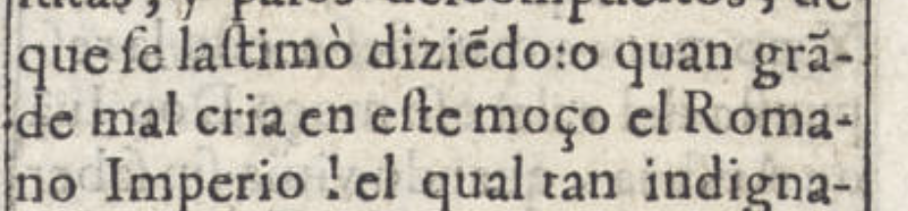
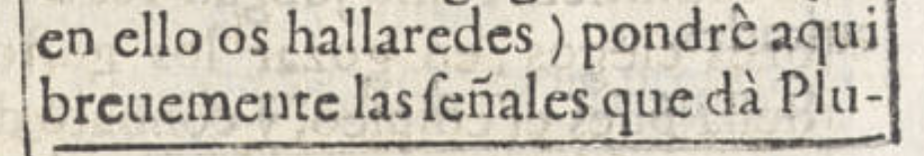
Expected irregularities
Tildes (horizontal “cap” – ignore grave/backwards accents)
When a q is capped, assume ue follows
When a vowel is capped, assume n follows
When n is capped, this is always the letter ñ
Possibility to check against a dictionary?

Slide 8
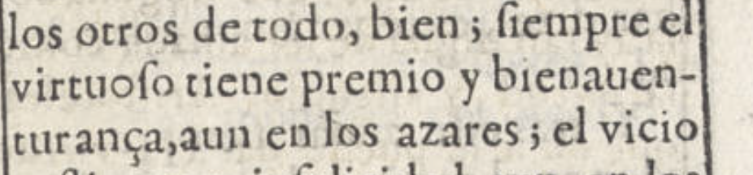
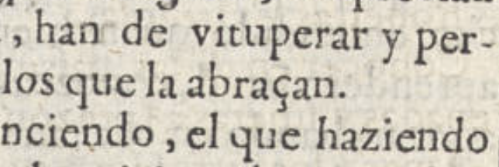
Expected irregularities
ç old spelling is always modern z
Teach AI to always interpret ç as z

Slide 9
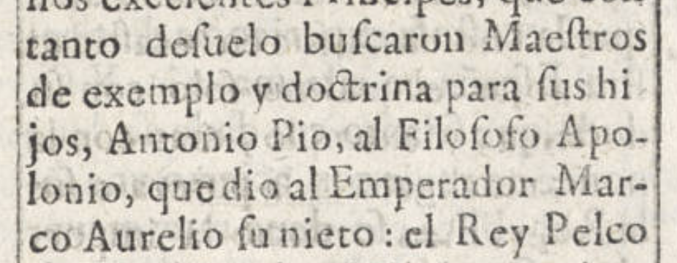
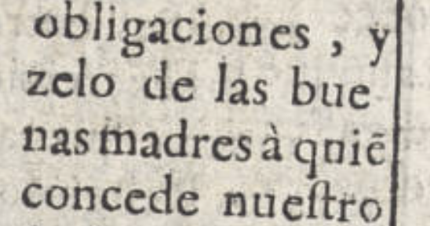
Expected irregularities
Some line end hyphens not present
Leave words split for now
Possibility to check against a dictionary?

